Slide 1
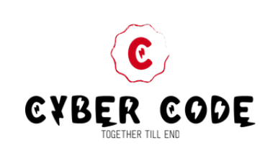
Game with Visual studio (C#)
Cyber code

Slide 2
Agenda
Introduction
Work Division
Planning And Designing
Development
Conclusion
Practical Demonstration of project

Slide 3

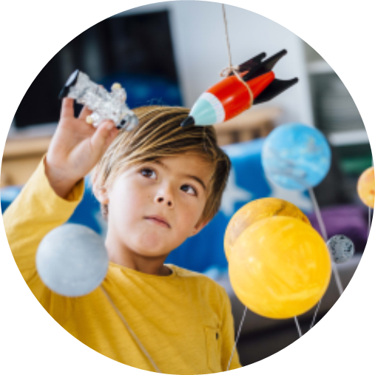
Introduction
As this Game is similar to 2D Platformer game (a style of video game where the player makes a character move through an environment with a series of action-based moves, like running, jumping, swing etc.) which is very interesting and entertaining game. Our game is very user friendly and easy to play.
In our game a character moves to complete the mission by collecting different treasure and whenever he starts moving after some times some obstacles are arrived in his way if the character passes the obstacles, then only, he can continue his journey if he touches any one of the obstacles, he gets damage or may die and the game restart from the beginning or from the checkpoints if he has reaches to the checkpoints.
Here we have used Visual Studio Code (a code editor redefined and optimized for building and debugging modern web and cloud application) for codding and debugging our project.
Godot (a feature-packed, cross-platform game engine to create 2D and 3D games from a unified interface) for the development of the game environment.
Libre sprite (an application with which we can edit and create animated pixels and sprite) for creating sprites in game.

Slide 4
Work Division
Team work

Slide 5
“Alone we can do so little; Together we can do so much”
Sangit Gyawali
Planning
Shiva Raj Poudel
Planning
Development
Saroj Neupane
Manish Khanal
Documentation
Module Designing
And Testing
Module
Designing
And Testing
And Coding
And Coding

Slide 6

Planning and Designing
Sangit Gyawali
And
Shiva Raj Poudel

Slide 7
Planning
First of all we have done some research and start searching for best project that can be made by us using visual programing (csharp). After some research me and one of our team member Shivraj Poudel planed to build some entertained project which may refresh to all of us i.e. game.
After that we have made some discussion with our other team members (Manish Khanal and Saroj Neupane). After Listening plan Saroj Neupane one of our team member has decided to use some game engines and sprite software which help us to build best gaming interface, setup environment and Sprite designing respectively.
And we have decided to use Godot-mono as a game engine and Libre sprite as sprite designing.

Slide 8
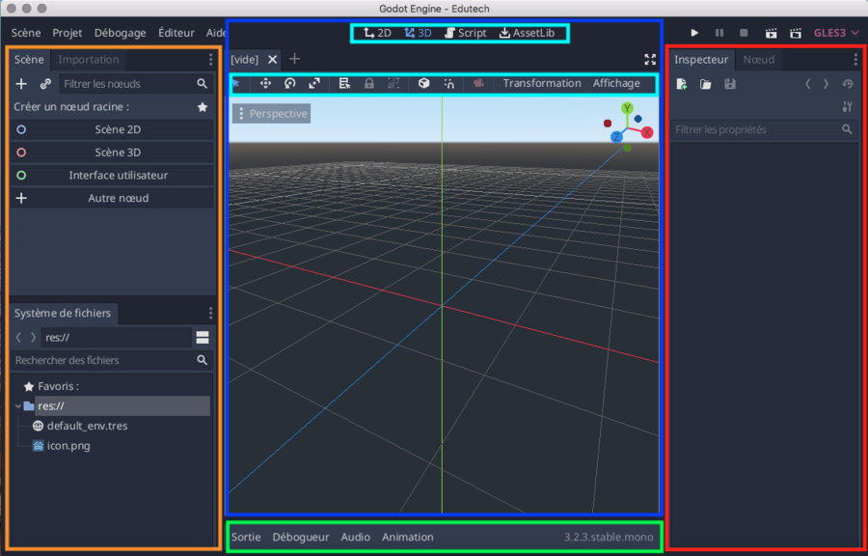
Then, what Godot-mono is ?
A feature-packed, cross-platform game engine to create 2D and 3D games from a unified interface which allows you to use C# as the primary language.
Godot aims to offer a fully integrated game development environment. It allows us to create a game, needing no other tools beyond those used for content creation (visual assets, music, etc.). The engine's architecture is built around the concept of a tree of "nodes".
Nodes are organized inside of "scenes", which are reusable, instance able, inheritable, and nestable groups of nodes. All game resources, including scripts and graphical assets, are saved as part of the computer's file system (rather than in a database).

Slide 9
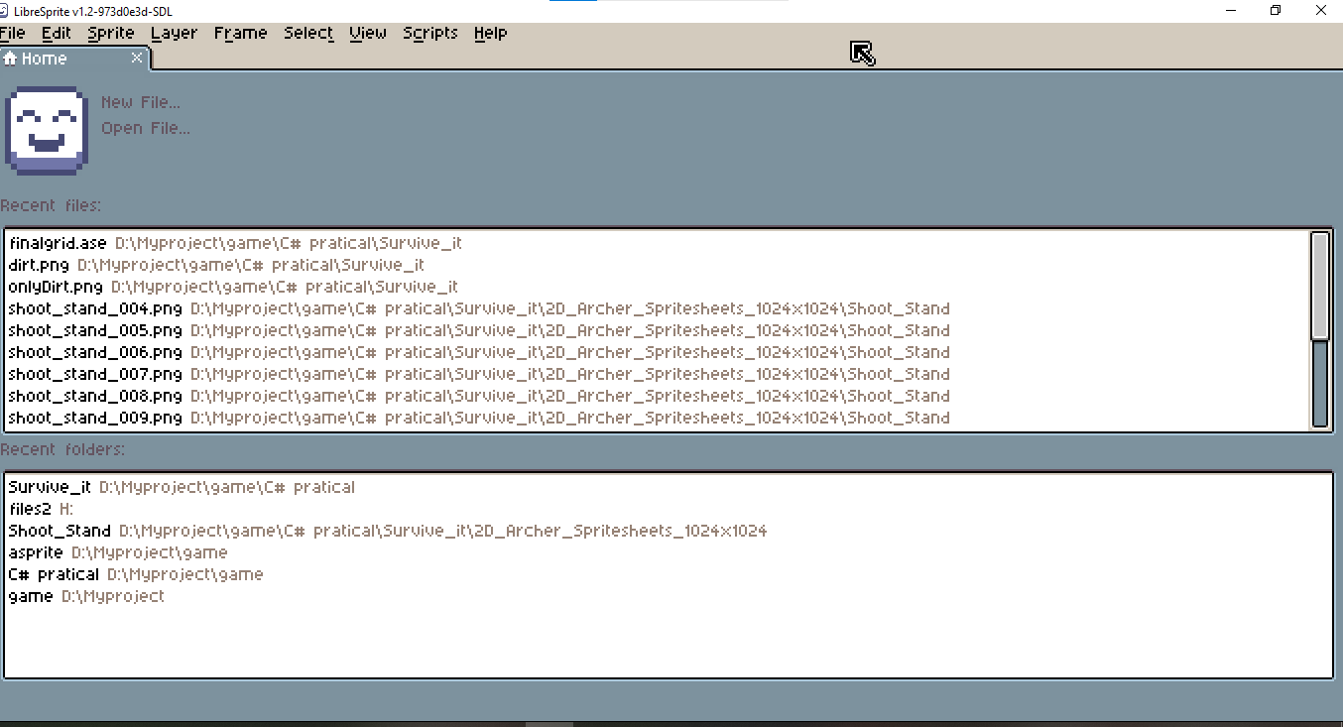
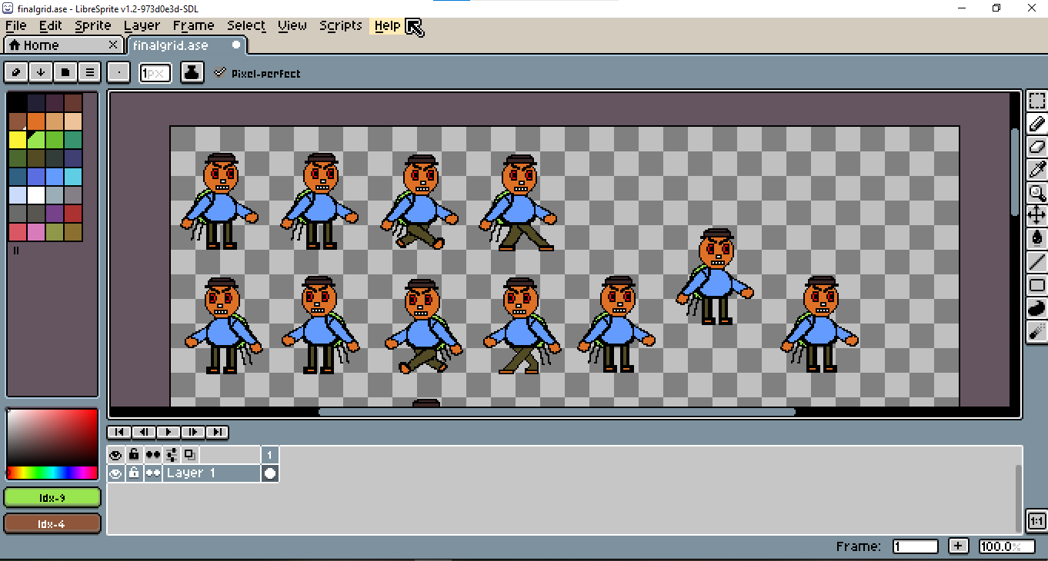
Then, what Libresprite is ?
An application with which we can edit and create animated pixels and sprite .
Sprites are composed of both layers & frames. Tiled drawing mode, useful to draw patterns and textures. Pixel precise tools like filled contour, polygon, shading mode, etc.

Slide 10
Designing
Shivraj Poudel
And
Sangit Gywalli

Slide 11
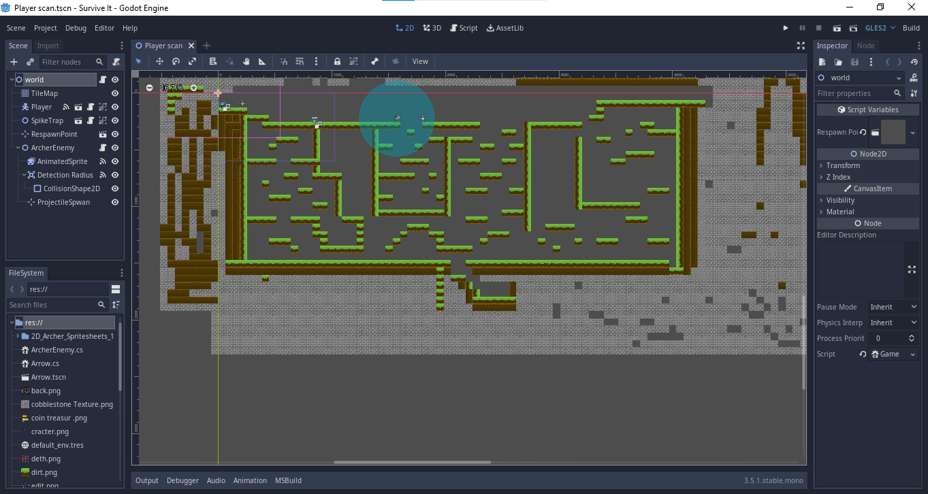
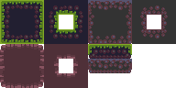
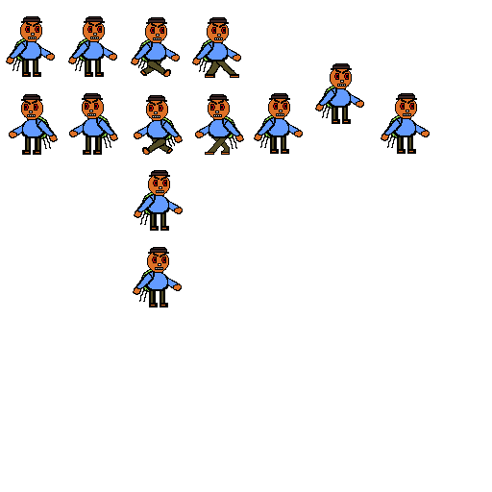
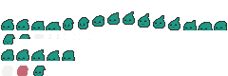
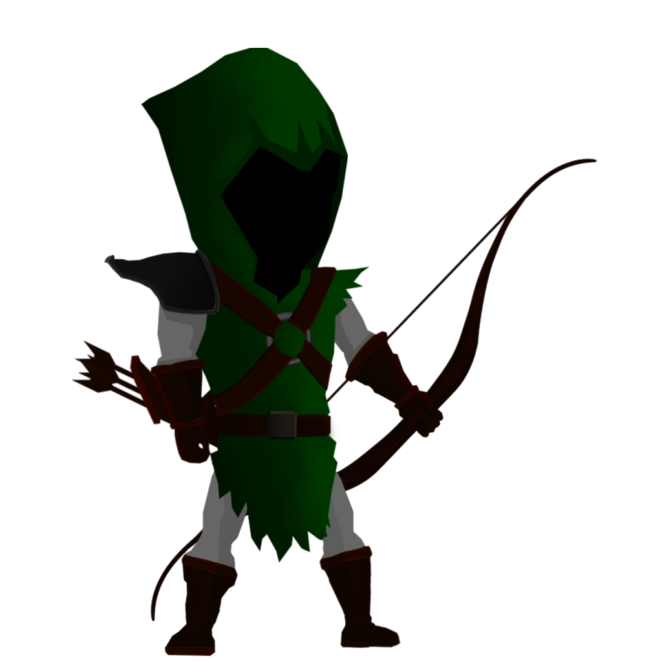

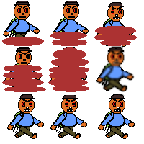
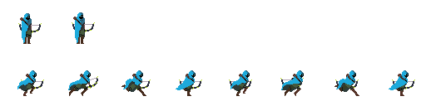
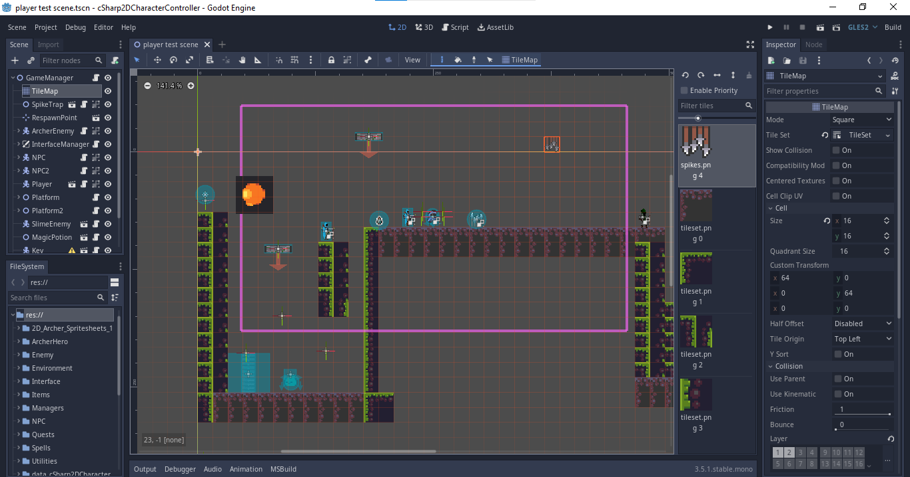
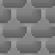

Designing
Character designing
Dirt and Obstacles
User interface and Tail set designing
Character:
Dirt

Slide 12
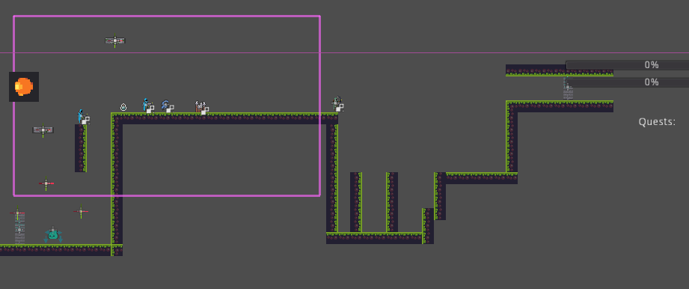
Game interface:
2D camera view
Magical power storage
Spike trap
Archer enemy
character
Helper
Health and power bar
Magical power
Door 2
Moving platformer
walls
Slime enemy
Door 1

Slide 13
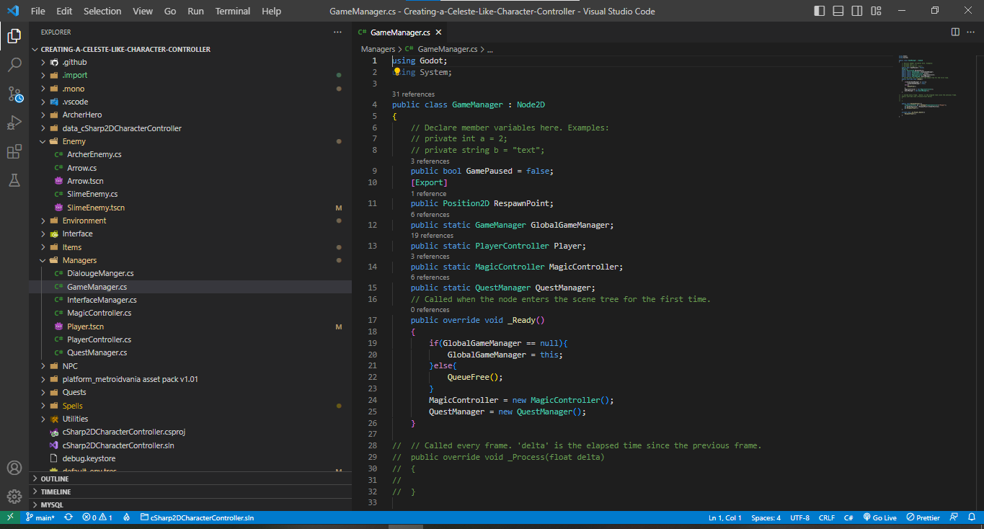
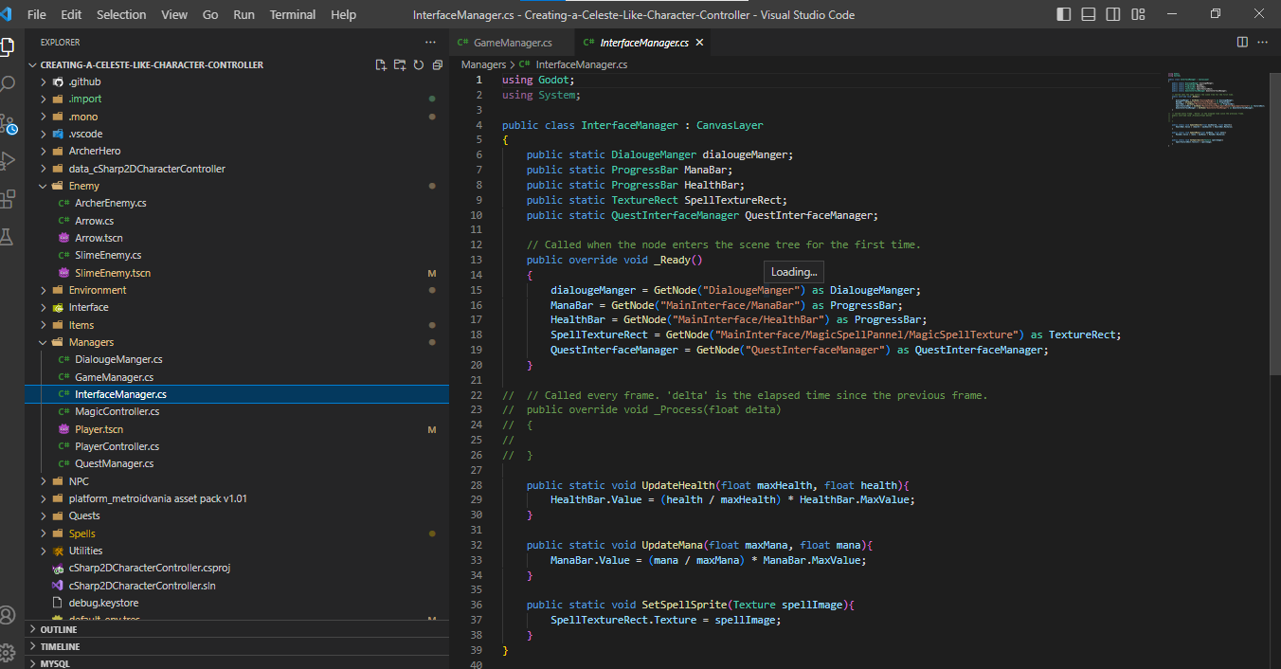
Development and coding:
Saroj Neupane
Manish Khanal
Game Manager
Player control
Enemy control
Interface Manager
Game Manager
Dialogs Manager

Slide 14

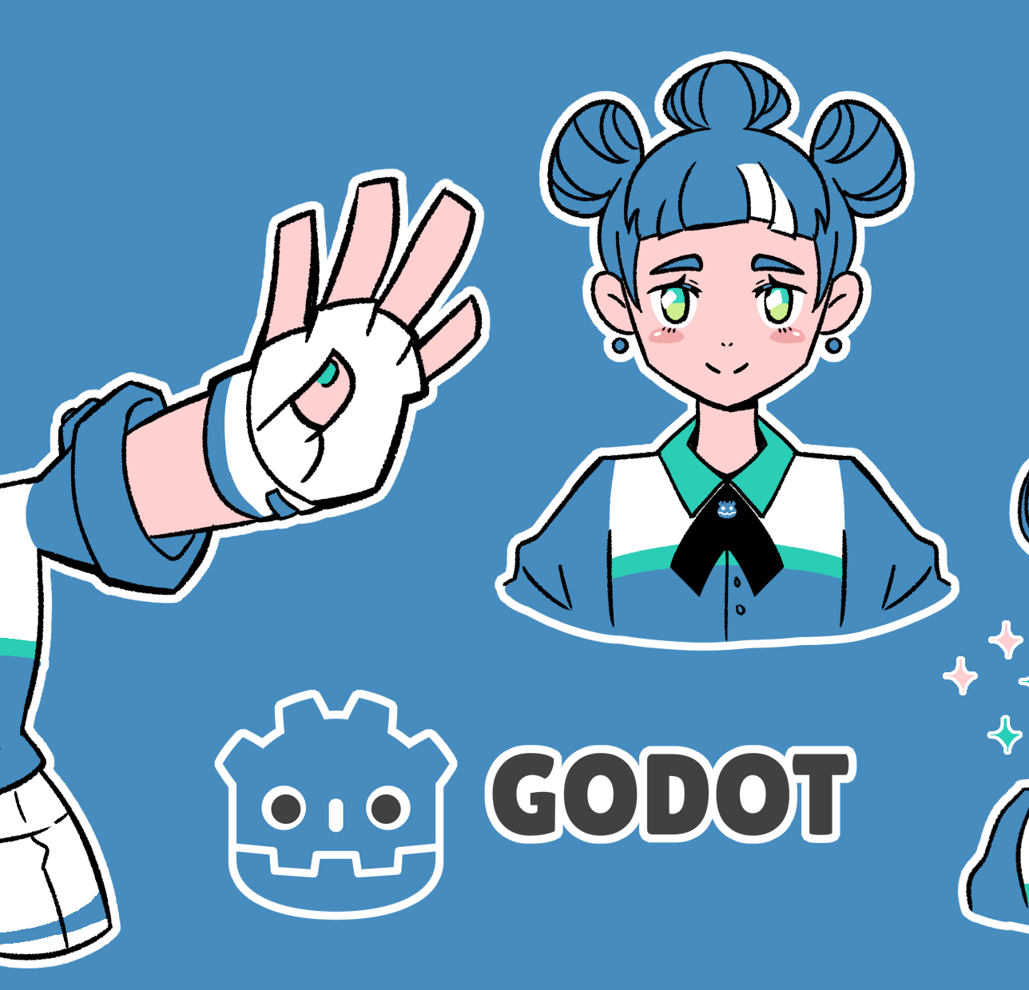
Summary
Project Survive and Hunt is a game project done in practical work of visual programming (C#) by Team Cyber-Code (Manish Khanal, Saroj Neupane, Sangit Gyawali, and Shiva Raj Paudel) student of Kalika Manavgyan Secondary School from class 12 Technical. This project has helped us to implement our all knowledge-based thing in real.

Slide 15
Team
Sangit Gyawali Designer
Shivraj Poudel Designer
Saroj Neupane Coder
Manish Khanal Doc manager

Slide 16
Thank you
Presented By:
Cyber_code.

